Slide 1
OneVA Pharmacy User Training
Backup Screen Shots

Slide 2
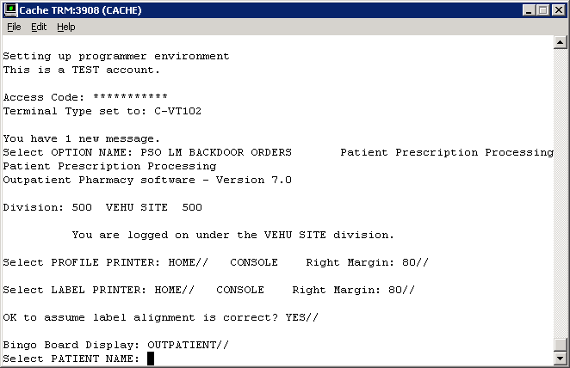
Screen 4-1

Slide 3
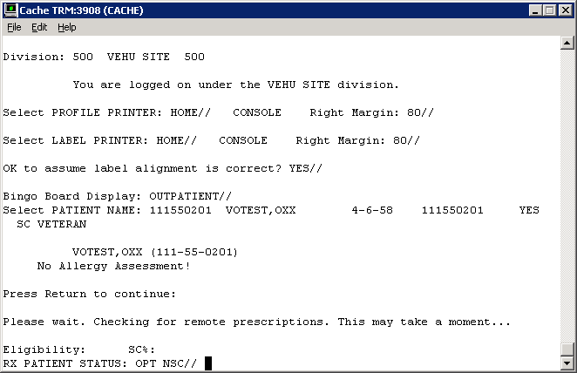
Screen 4-2

Slide 4
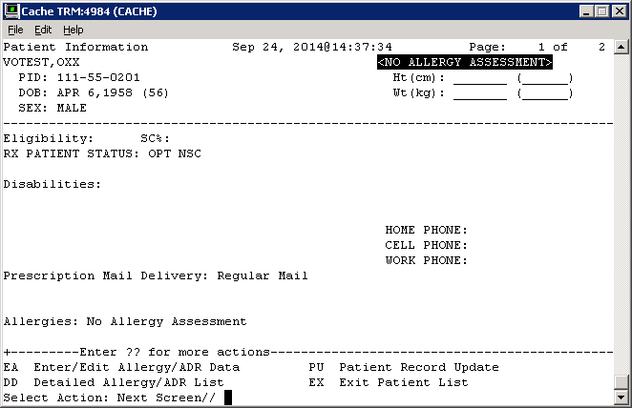
Screen 4-3

Slide 5
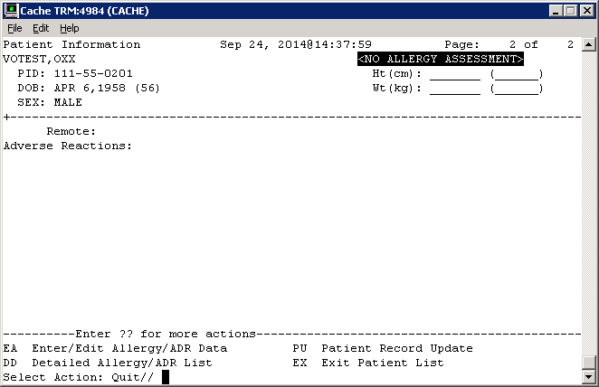
Screen 4-4

Slide 6
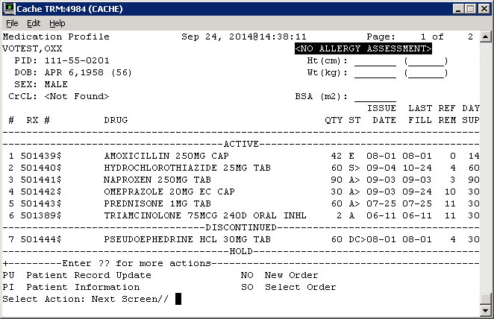
Screen 4.1-1a

Slide 7
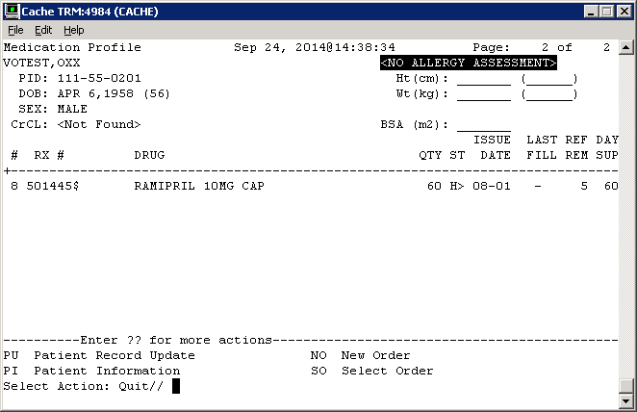
Screen 4.1-1b

Slide 8
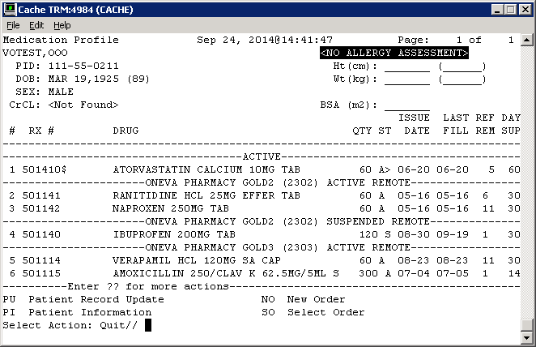
Screen 4.1-2

Slide 9
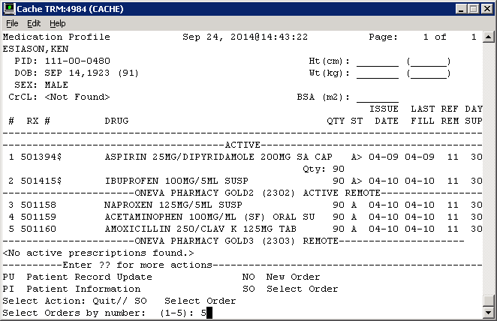
Screen 4.3.1-1

Slide 10
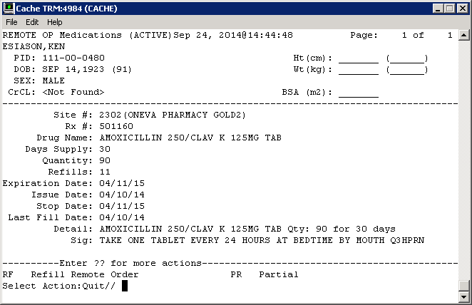
Screen 4.3.1-2

Slide 11
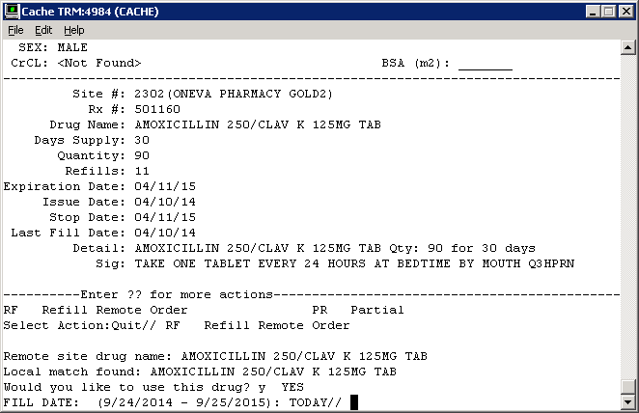
Screen 4.3.1-3 (needs Fill Date + Please be patient msg)

Slide 12
Screen 4.3.1-4

Slide 13
Screen 4.3.1-5

Slide 14
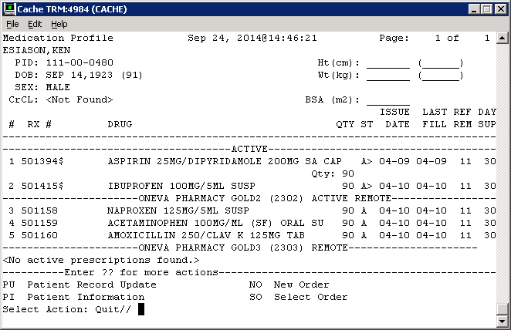
Screen 4.3.2-1

Slide 15

Screen 4.3.2-2

Slide 16
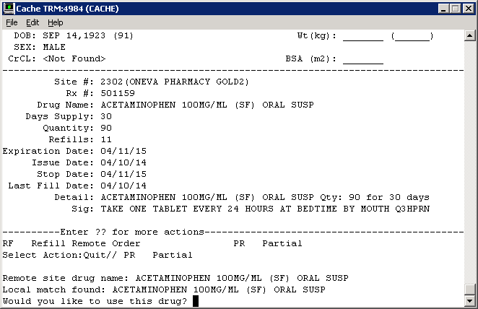
Screen 4.3.2-3

Slide 18
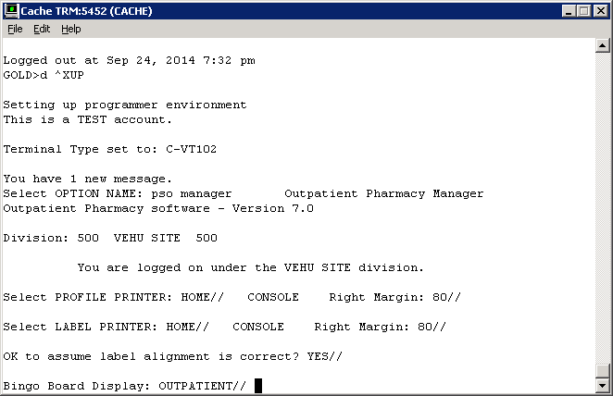
Screen 4.4-1

Slide 19
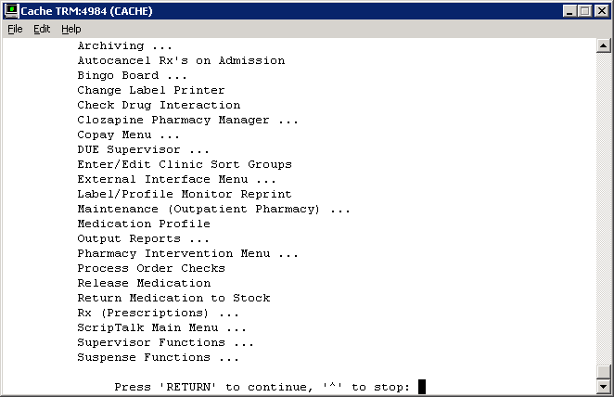
Screen 4.4-2

Slide 20
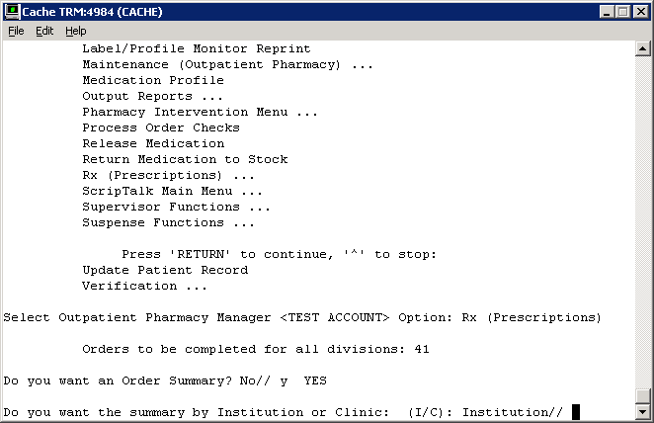
Screen 4.4.1-1

Slide 21
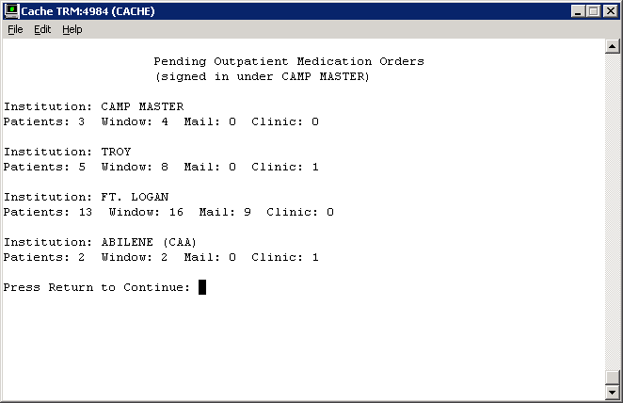
Screen 4.4.1-2

Slide 22
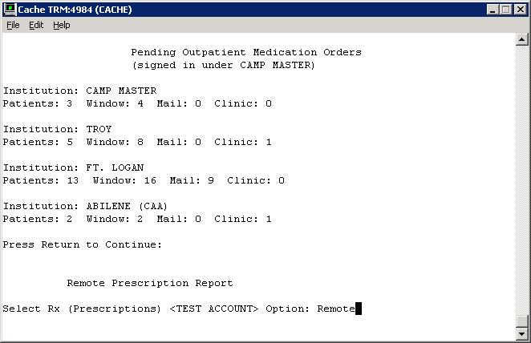
Screen 4.4.1-3

Slide 23
Screen 4.4.1-3

Slide 24
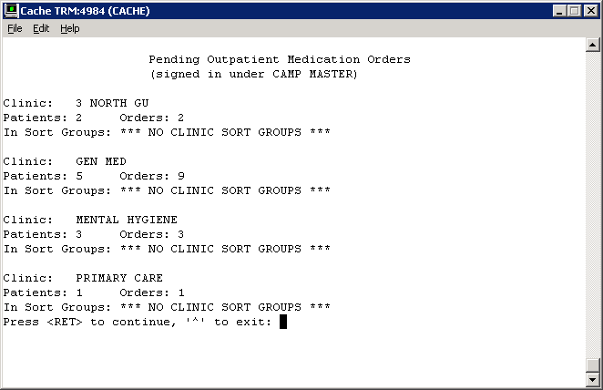
Screen 4.4.1-4

Slide 25
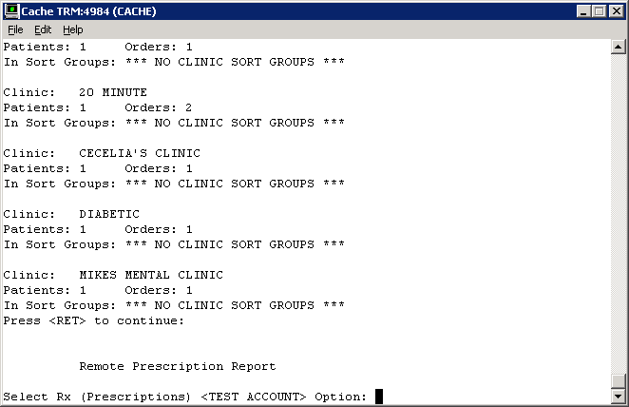
Screen 4.4.1-5

Slide 26
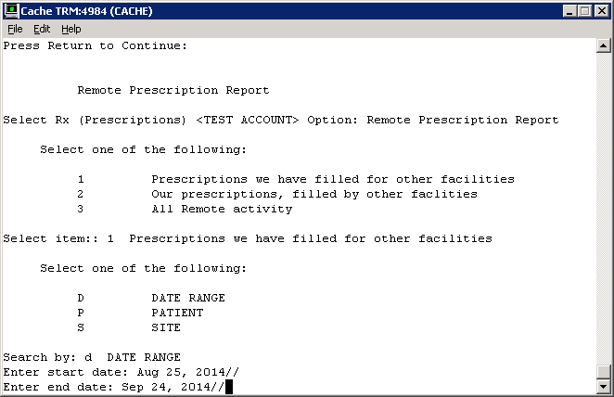
Screen 4.4.2-1

Slide 27
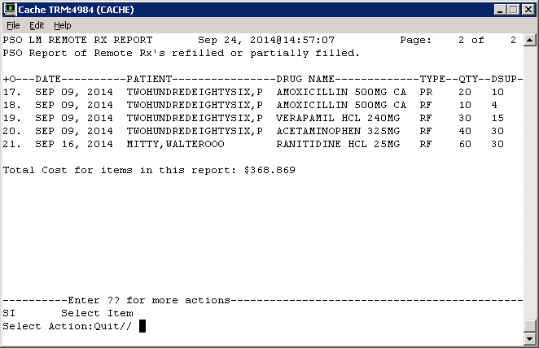
Screen 4.4.2-2

